Slide 1
Altera’s SoC FPGAs
Your User-Customizable System on Chip
Software Workshop Session
SoCKIT to Me!
Don’t Just Elevate, Integrate.

Slide 2
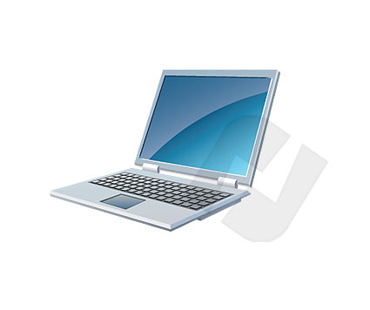
System Requirements
TOOLS INSTALLED
Quartus II Web Edition: v13.0
  Including Altera SoC Embedded Development Suite (EDS)
Quartus II Programmer
SignalTap II Analyzer
“PuTTY” Terminal Emulator
  Download open source copy: http://www.chiark.greenend.org.uk/~sgtatham/putty/download.html
LAPTOP OS and Memory
PC with Windows 7
i3 processor or better
10 GB Hard disk space for the SoC EDS (Embedded Dev Suite) v13.0
4 GB RAM
NOTE: If you don’t have the above tools installed, you may install them during the presentation – please ask for disks

Slide 3



Agenda
Altera’s SoC Devices & Dev Tools Overview
Arrow’s SoCkit Overview
Altera’s SoC EDS (Embedded Development Suite)
Software Debug & Trace Interfaces & Tools
Software Development Flow – Part 1 – Preloader & Bare-Metal
  Lab: Modules 1 thru 3: Getting started, Generate/run/debug Preloader
Software Development Flow – Part 2 - Embedded Linux
  Lab: Modules 4 & 5: Validate new peripheral running Linux
Advanced Debug
Altera and the Linux Community
  Demo / Lab (time permitting): Advanced debug – cross triggering
Resources & Next Steps

Slide 4
Altera’s SoC Devices & Development Tools

Slide 5






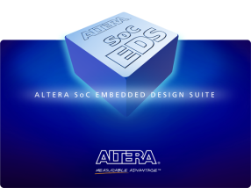



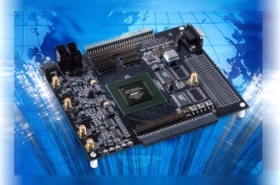

A Complete Solutions Portfolio
Lowest Cost, Lowest Power
CPLDs
Lowest Cost,
Lowest Power FPGA
Cost- and Power-Optimized
FPGA
Highest Bandwidth
FPGA
Lowest Risk, Lowest Total Cost
ASICs
MIPS Technology
Embedded
Hard & Soft Processors
& Development Suites
Intellectual Property (IP)
FPGA
Design
Software
Development
Kits
Notes:
Note that our product strategy is more than just about the silicon. Productivity oriented development tools, IP and development kits are key to Altera’s ability to make customers successful.

Slide 6
SoC System Architecture
Hard Processor System (HPS)
Processor
  Dual-core ARM® Cortex™-A9 MP Core™ processor
  4,000 MIPS (up to 800 MHz per core)
  NEON coprocessor with double-precision FPU
  Rich set of embedded peripherals
  32-KB/32-KB L1 caches per core
  512-KB shared L2 cache
Multiport SDRAM controller
  Up to 533-MHz DDR3 and LPDDR2*
  Up to 400-MHz DDR2
  Integrated ECC support
  Cache coherency between ARM & FPGA IP
High-bandwidth on-chip interfaces
  > 125-Gbps HPS-to-FPGA interface
  > 125-Gbps FPGA-to-SDRAM interface
ARM Cortex-A9
NEON / FPU
L1 Cache
ARM Cortex-A9
NEON / FPU
L1 Cache
USB OTG (x2) ⁽¹⁾
Ethernet
(x2) ⁽¹⁾
L2 Cache
GPIO
I²C
(x2)
(x4)
QSPI Flash Control
64-KB
RAM
JTAG Debug / Trace ⁽¹⁾
HPS I/Os
SPI
(x2)
CAN
(x2)
(x4)
NAND
Flash
⁽¹⁾ ⁽²⁾
SD / SDIO/ MMC ⁽¹⁾
Timers
(x11)
DMA
(8 Channels)
UART
(x2)
Shared Multiport DDR SDRAM Controller ⁽²⁾
HPS to
FPGA
FPGA
to HPS
FPGA
Configuration
FPGA
28LP process
8-input ALMs
Variable-precision DSP
M10K memory and 640-bit MLABs
fPLLs
FPGA General Purpose I/Os
Hard Multiport DDR SDRAM Controller ⁽²⁾
Hard
PCIe
3-, 5-, 6-,
and 10-Gbps Transceivers
Multiport DDR SDRAM Controller
PCIe
Multiport DDR SDRAM Controller
Notes:
Integrated direct memory access (DMA)
Integrated ECC
* LPDDR2 support coming
Notes:
Here’s a more detailed block diagram of the SoC FPGA. The portion in blue is the HPS, and it contains the dual-core processor, each CPU with its own floating-point unit, NEON coprocessor, and L1 caches. The processors share a 512-KB L2 cache and a rich set of peripherals, including two triple-speed Ethernet ports, two USB on-the-go ports, interfaces to flash memory, general-purpose embedded peripherals such as UART, SPI, CAN, and I²C, and a shared multiport DRAM controller that supports DDR2, DDR3, and later in the year LPDDR2 – all with ECC.
Two high-bandwidth interfaces connect the HPS and FPGA fabric, with a third interface dedicated to low latency traffic from the processor to the FPGA. The processor has direct access to the FPGA configuration controller so it can configure the FPGA under program control.
The green portion represents the FPGA fabric and the grey blocks represent additional hard IP functions available to your custom logic, including additional multi-port DRM controllers, PCIExpress ports, and high-speed serial transceivers.
The HPS and FPGA have their own dedicated I/O and can are share some I/O functions when necessary. More on that later.

Slide 7


SoC Software Development Tools
Software Development Tools
  Altera’s SoC Embedded Development Suite (EDS)
    GNU Tools, Utilities, Libraries
    ARM Design Studio 5 (DS-5)
    Altera – Exclusive FPGA Adaptive
  Lauterbach TRACE32
  Wind River Workbench
  ENEA Optima
Notes:
You can work with the same tools you already know, today on the Virtual Target, later on the physical device.
We plan to support all the major operating systems on our device. Several are already available on the Virtual Target today. More will be available with time.
For more information on the Virtual Target and how to get started on software development today, contact your Altera sales representative.

Slide 8






Embedded SW Availability
Vendor | OS/RTOS | Development Tools | Availability
Open Source | Linux 3.7 | Linaro compiler | Now through Altera
Wind River Systems | VxWorks 6.9.2 | Workbench 3.3.2 | Q2 2013 (beta now)
Micriµm | µC/OS-II, µC/OS-III | GNU compiler | Q2 2013 (beta now)
Enea | OSE 5.5.3 | Optima 2.6 | Q2 2013 (beta now)
Express Logic | ThreadX 5.5.3 | GNU compiler | Q2 2013 (June)
Wind River Systems | Wind River Linux 5 | Workbench/GNU | Q2 2013 (June-Wind River EAR)
QNX | QNX/Neutrino 6.5.3 | Momentics | Q3 2013 (July)
Fujisoft | Android | GNU compiler | Q2 2013 (June)
Green Hills | INTEGRITY | Multi/Green Hills | Q3 2013 (July)
Microsoft | Windows Embedded 7 | Microsoft/Studio | Q3 2013 (August)

Slide 9
Arrow’s SoCkit Overview

Slide 10
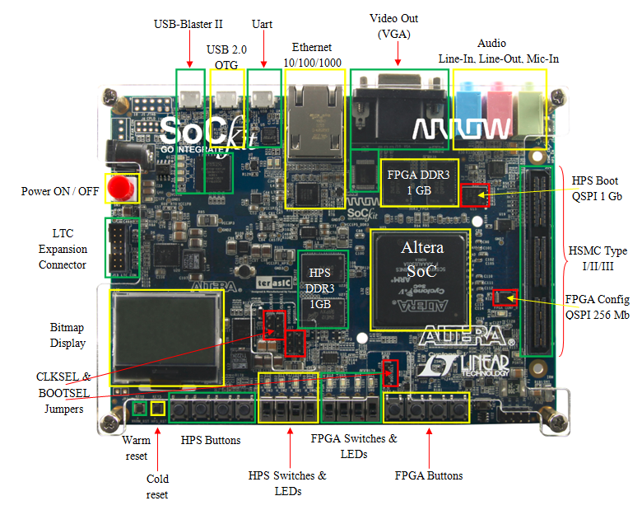
Arrow’s SoCkit Development Board
Based on:
Cyclone V SoC FPGA

Slide 11

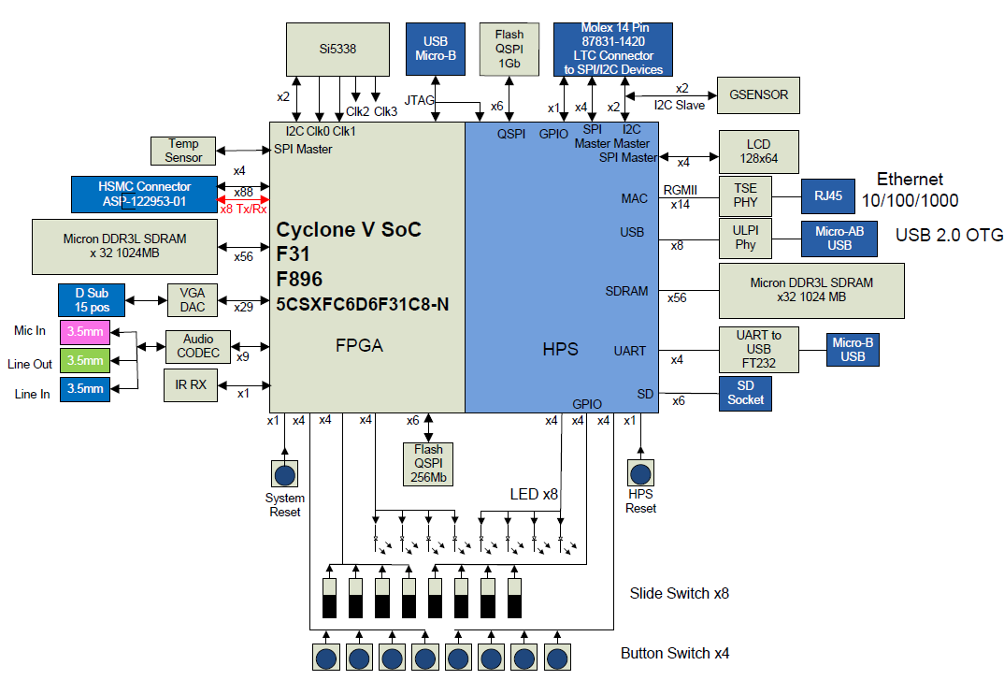

Arrow Cyclone V SoCKit
Button Switch x8

Slide 12
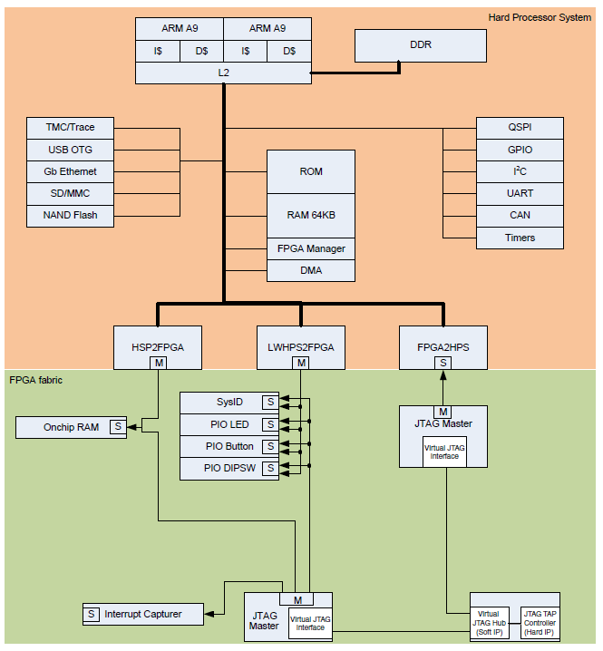
Golden Reference Design
HPS configuration
  DRAM, QSPI, SD/Card
  All peripheral functions exposed at least once
FPGA configuration
  Simple Qsys “sandbox” system
    First experience in ARM / FPGA integration
  Getting started guide to walk them through the process on integrating IP
    HW simulation
    Verification via system console
    Verification via CPU
    HW/SW hand-off

Slide 13
Arrow’s SoCkit Dev Board – HW Features
Cyclone V SOC FPGA
Compact Board Size: ~15x10 cm (6” x 4”)
ARM Cortex-A9 based Hard Processor System (HPS)
  Full set of peripherals (Flash I/F’s, GbE, USB, SD, SPI, I2C, CAN, UARTs, DMA’s, Timers…)
Two independent banks of DDR3: 4GB (x32) @ 533MHz
GbE Ethernet
USB 2.0
  OTG
  UART to USB
SD Card Socket (Support 4-bit SD mode)
Display
  24-bits RGB VGA
  Graphic LCD: 128x64
Notes:
Drivers for all HPS peripherals available and included. Drivers for VGA, audio and sensors posted soon.

Slide 14
Arrow’s SoCkit Dev Board – HW Features (2)
General Peripheral: LEDs / Buttons / Switches / IR
Audio CODEC: Line-In, Line-Out, Mic-In
Temperature Sensor
G-Sensor
On-Board USB-Blaster II (Config/Debug cable interface)
Expansion Headers
  HPS IP: LTC (Linear Tech) Header
  FPGA fabric: High Speed Mezzanine Connector (HSMC) including transceivers
Note: For Mictor Dstream connectors – see the Altera SoC Dev kit

Slide 15
Altera’s SoC Embedded Design Suite (SoC EDS)

Slide 16
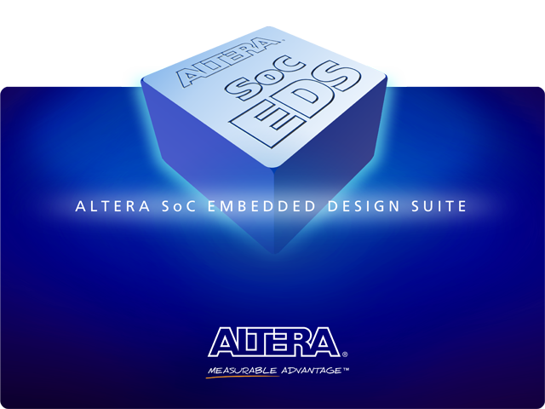
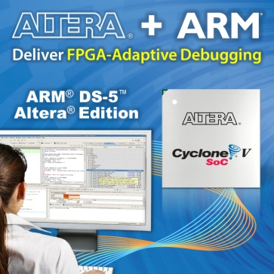
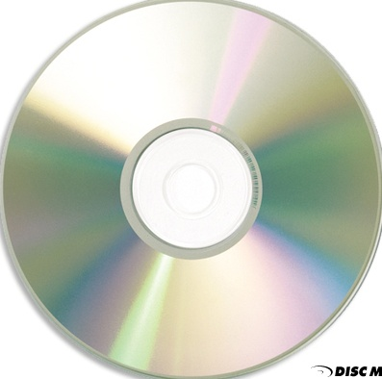


Altera SoC Embedded Design Suite
Comprehensive Suite of SW Dev Tools:
Hardware / Software Handoff Tools
  Preloader Generator: Parameterizes files for Preloader/BSP
  Device Tree Builder (Linux) (13.0 SP1)
Driver Development, Board Bring-up
Bare-metal application development
  SoC Hardware Libraries
  Bare-metal compiler tools
FPGA-adaptive debugging
  ARM DS-5 Altera Edition Toolkit
  Seamless FPGA peripheral visibility
Linux application development
  Yocto Linux build environment
  Pre-built binaries for Linux / U-Boot
  Work in conjunction with the Community Portal
Design examples
Altera
Exclusive
SoC EDS
Unprecedented Visibility and Debug Capability!

Slide 17
SoC EDS Contents
Component | Key Feature | Web Edition | Subscription Edition | 30-Day Evaluation
Hardware/Software Handoff Tools | Preloader Image Generator | x | x | x
 | Flash Image Creator | x | x | x
 | Device Tree Generator (Linux) | x | x | x
ARM DS-5 Altera Edition | Eclipse IDE | x | x | x
 | Debugging over Ethernet (Linux) | x | x | x
 | Debugging over USB-Blaster II JTAG |  | x | x
 | Automatic FPGA Register Views |  | x | x
 | Hardware Cross-triggering |  | x | x
 | CPU/FPGA Event Correlation |  | x | x
Compilers | Linaro Tool Chain (Linux) | x | x | x
 | CodeBench Lite EABI (Bare-metal) | x | x | x
Hardware Libraries | Bare-metal programming Support | x | x | x
SoC Programming Examples | Golden System Reference Design | x | x | x
* Not available in 13.0

Slide 18
Altera SoC EDS Additional Deliverables
Golden Hardware Reference Design (GHRD)
Pre-built: Linux Kernel, Root FileSystem, U-Boot
  Pre-built with full source (Linux snapshot)
  Link to community website for updates
Software Example Designs:
  Hello World Bare metal (GNU)
  Hello World Bare metal (armcc)
  Hello World for Application Linux
  Linux simple device driver example design
  Linux Web Server simple driver
Notes:
We will discuss these as we go through the presentation

Slide 19
Software Process: HPS Boot Stages
Boot ROM code
Hardened by Altera into device.
Scans boot select pins to determine clocks/boot source
- NAND, QSPI, SD/MMC, FPGA or On-chip RAM
Sets up PLL’s if selected by clock pins
Configure minimal set of HPS I/O pins to read flash
Performs CRC checking & loads ISW into On-Chip RAM
Reset
SW / FW
Developer’s
efforts
Boot ROM
PreLoader (Initial Software)
Altera Reference code + generated system .c & .h files
Runs from On-Chip memory
Configures scan manager with pin configuration data
Initializes and calibrates SDRAM
Loads Boot Loader code into SDRAM
PreLoader
Boot Loader
Boot Loader
Application / OS specific
Altera provides U-Boot as a reference example
OS
Operating System
Linux, VxWorks, OSE, etc
Device drivers and BSP
Root FileSystem
Application
User Application
IDE and Debug
FPGA configuration

Slide 20
Hardware-Software Handoff: PreLoader Generator
Generates & Parameterizes files for making the PreLoader / BSP
Reset
Hard coded in HPS
Boot ROM
PreLoader “Initial Software (ISW)” or
“Secondary Program Loader (SPL)”
Low level hardware-centric source code
Runs from On-Chip memory
Configures scan manager with pin configuration data
Initializes and calibrates SDRAM
Loads Boot Loader code into SDRAM
PreLoader
Boot Loader
OS
uBoot - common bootloader – popular for Linux
Application

Slide 21
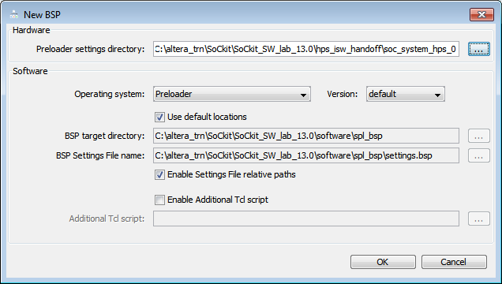
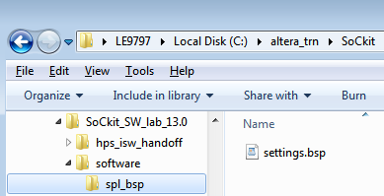
Hardware-Software Handoff: PreLoader Generator
PreLoader Generator Highlights
  Deciphers hardware handoff files and generates settings for PreLoader/BSP makefile generation
  Initiated from Command Shell
  GUI for configuring BSP related parameters, files
  INPUTS (Quartus/Qsys files):
    Directory location of handoff files
  OUTPUTS:
    BSP Settings file (settings.bsp)
    PreLoader source code & makefile

Slide 22
Generated Software Handoff Files
File | Description
emif.xml | SDRAM parameters
hps.xml | Enables modules and pinmuxing
id | Checksum
<QSYS_HPS_SYSTEM_NAME>_hps_0.hiof | Binaries of IOCSRs
all_types.h | Source Code for debugging, SDRAM sequencing, etc.
sdram_io.h
sequencer.c & .h
sequencer_defines.h
system.h
tclrpt.c & .h
No need to memorize – point the tool to the handoff directory
Files location: <quartus project>/hps_isw_handoff/<hps entity name>

Slide 23
Additional Generated Files
File | Description
<QSYS_HPS_SYSTEM_NAME>_hps_0_hps.svd | CMSIS-SVD file shows registers of soft IP in FPGA
<QSYS_HPS_SYSTEM_NAME>.sopcinfo | XML file describes FPGA hardware system
Files location: <quartus project>/<Qsys_HPS_SYSTEM_NAME>

Slide 24
SoC Boot Phases to Bare-metal or OS
Recommended Flow
Typical OS
Boot Process
Boot
ROM
Preloader
Bootloader
OS
Application
Bare-Metal Application
Boot
ROM
Preloader
Bootloader
Bare-Metal Application
Bare-Metal Application
Boot
ROM
Preloader
Bare-Metal Application
Bare-Metal Preloader Replacement
Boot
ROM
Bare-Metal Application
Boot ROM | Preloader | Bootloader | OS | Apps
Boot Phase
Notes:
Complex Application processors like the Cortex-A9 are designed to run with Operating systems. Altera does offer libraries and a generic configuration for Bare-metal development, but with 100’s of registers in the core, custom bare-metal designs are discouraged.

Slide 25
HW Libraries & OS/Bare-Metal Development
Bare-metal
  No Operating System
  User code and hardware libraries/drivers
Hardware Libraries
  Software interface to all system registers
  Functions to configure some basic system operations
  (e.g. clock speed settings, cache settings, FPGA configuration, etc.)
  Support board bring-up and diagnostics
  Can be used by bare-metal application, device drivers, or RTOS
GNU-based bare-metal (EABI) compiler tools
Bare-metal App
Application
Bare-metal App
Operating System
BSP
Hardware Libraries
HWLIB
HPS

Slide 26
APIs in HWLIB (Bare-metal)
Phase 1
Phase 2
(V13.1)
MPU Subsystem
Timers
Test Support Mgmt
UART
Cache Mgmt
Memory Map Cntl
Watchdog
ECC/Parity Error
UART
Address Filters
General Purpose
Basic Mem Tests
JTAG UART
Mem Coherence
Bridge Management
Flash Memory Intrf
FPGA Manager
FPGA2HPS
QSPI
MMU Mgmt
Full Configuration
HPS2FPGA
NAND
Interrupt Ctrl
Partial Reconfig
LWHPS2FPGA
SD/MMC
Pin I/O Cnf Mgmt
Clock Manager
System Manager
GPIO
ECC Mgmt
Reset Manager
SDRAM Ctrl
DMA
Parity Mgmt
SoCAL Layer (non ARM IP)
SoCAL Layer (ARM IP)
Notes:
Supports MPU Subsystem
Caches
MMU
Interrupt Ctlr
ACP/SCU
Support Peripherals:
Bridges (Axi, etc.)
Clock Mgr
FPGA Mgr
Reset Mgr
System MGR
Timers/GPT/WDT
DMA
Interface Peripherals:
Pin I/O Cfg
GPIO
Flash Memory
SDRAM Ctlr
Cache management
UART
Also example tests (example code to test out peripherals)

Slide 27
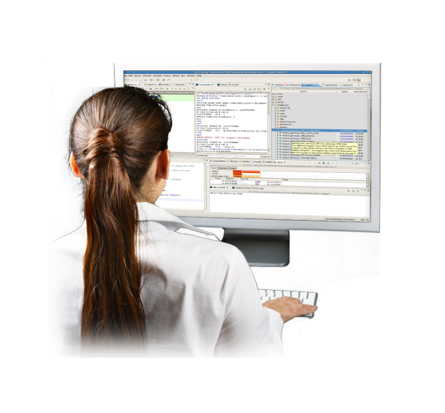
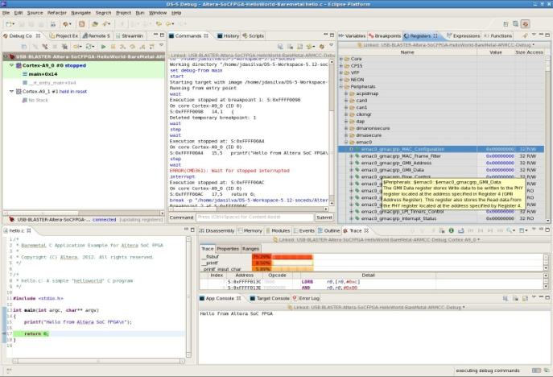
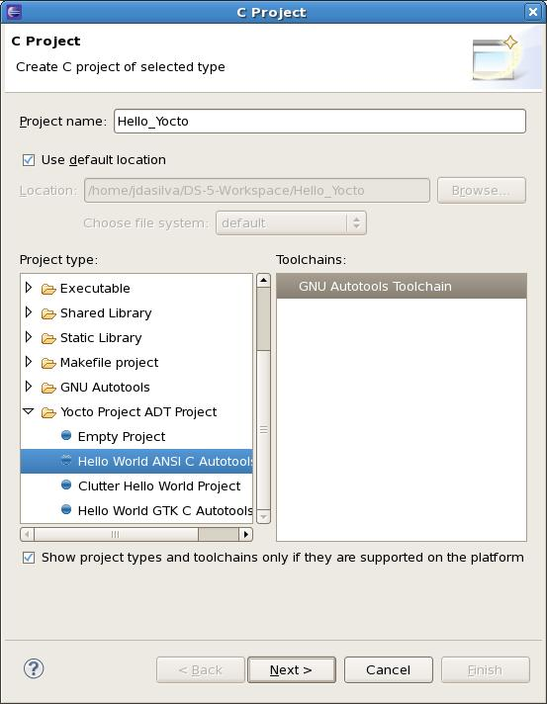
SoC EDS Includes ARM DS-5 Altera Edition
Industry’s most advanced multicore debugger from ARM for ARM processors
Supports JTAG/Ethernet/Trace debug in one package
Trace pod – Dstream – 4Gbyte trace memory
True dual core/debugger capability
Streamline: Statistical analysis of software load and bus traffic spanning the CPUs and FPGA under Linux
Integrated OS-aware analysis
and debug capability
Yocto plugin to enable
Linux based application development
Notes:
ARM: This slide illustrates that the Altera Edition has all the functionality of ARM’s DS-5 debugger. DS-5 is already a powerful debugger, and there are no limitations at all for Altera Edition, except that it only works for Altera devices. Gives customers all the visibility into the design needed for the job. For example, engineers will benefit from the industry’s most advanced multicore debugger for ARM, can run Linux, can see processor mode, and get all the functionality they would get from an expensive debugger.
The screenshot at the back shows the graphical user interface of DS-5 Debugger.
The screenshot on top shows the Eclipse “New C Project” dialog when the Yocto Eclipse plug-in is installed. The Yocto plug-in enables you to more easily create Linux projects for a hardware target with changing peripherals. This is discussed later in the Linux flow section.

Slide 28

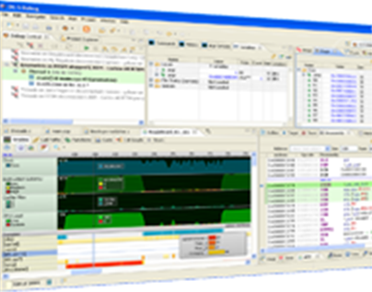
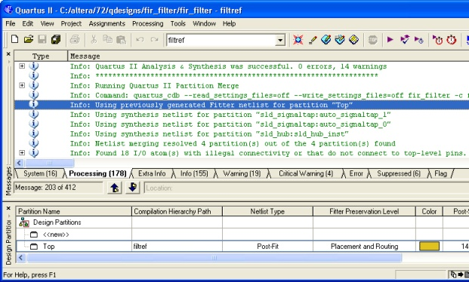
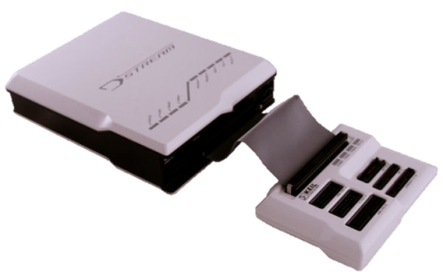
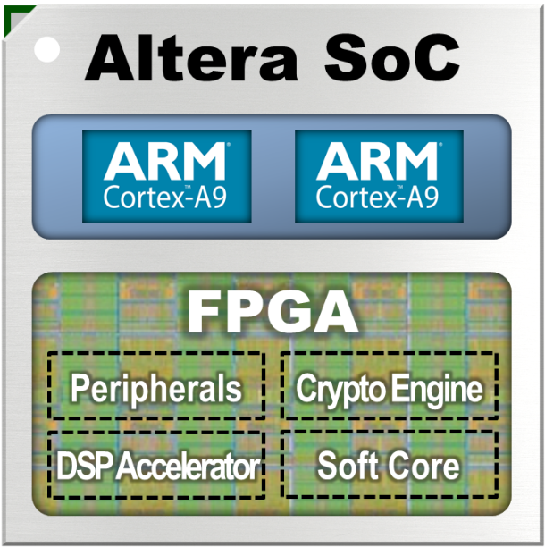
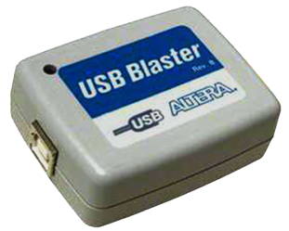
One Device, Two Debugging Tools?
ARM® DS-5™ Toolkit
Altera Quartus™ II Software
JTAG
DSTREAM™
Dedicated JTAG connection
Visualize & control CPU subsystem
JTAG
Dedicated JTAG connection
Visualize & control FPGA
Notes:
Altera to present

Slide 29
One Device, Two Debugging Tools?
ARM® DS-5™ Toolkit
Altera Quartus™ II Software
Debugging
Barrier
No single tool/cable to visualize and control both CPU and FPGA domains
No way for CPU and FPGA to cross trigger and correlate hardware and software events
No “fixed” debugger can address the needs of
“changing” FPGA hardware
JTAG
DSTREAM™
Dedicated JTAG connection
Visualize & control CPU subsystem
JTAG
Dedicated JTAG connection
Visualize & control FPGA
Notes:
Altera to present

Slide 30


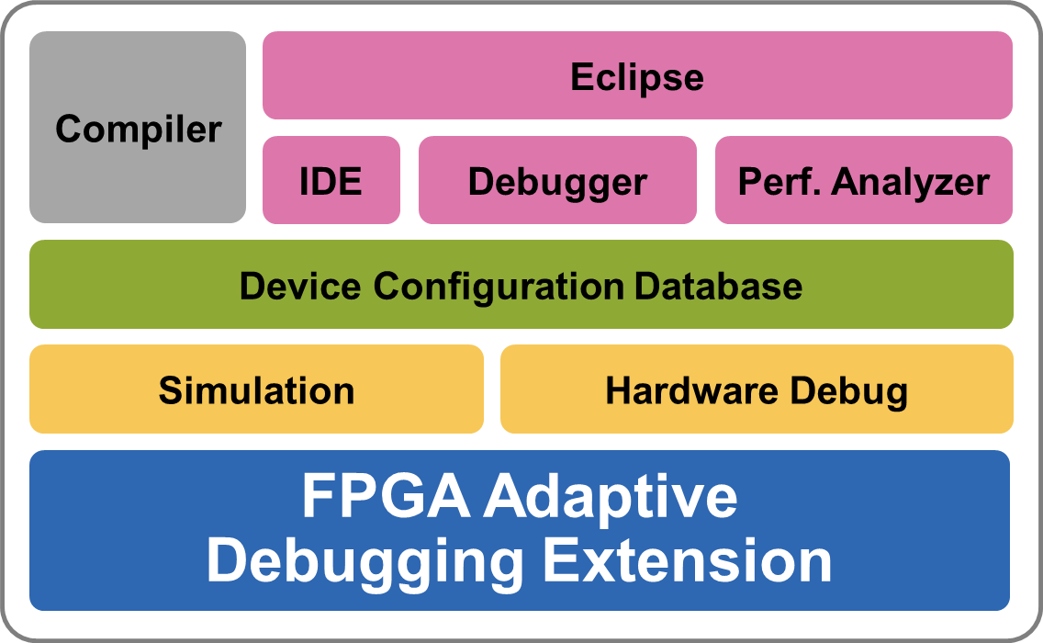
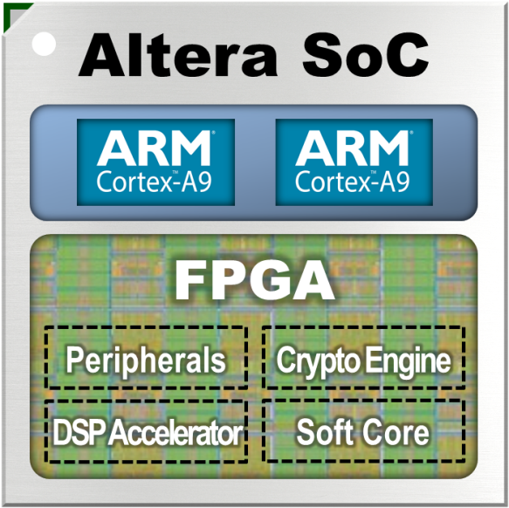
Industry First… FPGA-Adaptive Debugging
ONE
Connection
Altera
USB-Blaster™
Connection
ARM® Development Studio 5 (DS-5™) Altera® Edition Toolkit
Removes debugging barrier between CPUs and FPGA
Exclusive OEM agreement between Altera and ARM
Result of innovation in silicon, software, and business model

Slide 31
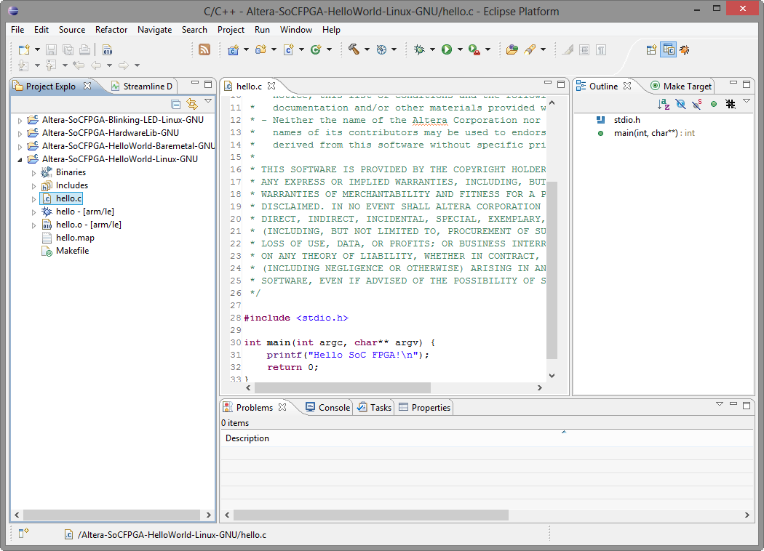
Familiar Eclipse Framework
Select Perspective
File Viewer
Outline View
(View functions, enums, classes, structs etc.)
Projects
Terminal Window

Slide 32
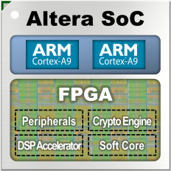

DS-5 Altera Edition
Productivity-Boosting Features
Single USB-Blaster target connection
for software and hardware debug
Automatic creation of register views
of FPGA peripherals
Hardware cross-triggering between the CPU and FPGA domains
Non-intrusive trace of CPU software instructions correlated with application events and FPGA hardware events
Simultaneous debug and trace for Cortex-A9 cores AND cores synthesized on FPGA*
Streamline support: Statistical analysis of software load and bus traffic spanning the CPUs and FPGA
ONLY SoC Technology… Altera’s SoC’s can achieve this
* For CoreSight™ -compliant cores: IP added using proper handoff files (CMSIS)
Notes:
Altera’s SoC Technology is the only one with the combination of silicon and SW Debugger features capable of cross triggering between HW and SW domains.
That is: A HW event and trigger causing a simultaneous SW trace trigger – and vice versa – a SW event and trigger initiating SW trace and simultaneously triggering hardware trigger & capture.

Slide 33
SoC EDS: Pricing and Availability
 | Purchasing Options | Description | Pricing
Subscription Edition | 30-Day Evaluation | - Full featured / Firmware development Altera FPGA Adaptive Debug gdbserver-based Linux Debug JTAG connectivity / USB Blaster II Ethernet connectivity | Free
 | SoC EDS Subscription Edition (Software only purchase) (ESW-SOCEDS-DS5-FIX) |  | $ 995
 | Included in CV SoC Dev Kit (DK-DEV-5CSXC6N/ES) |  | $1595 (kit)
Web Edition | Free Download | - Preconfigured for Altera SoC gdbserver-based Linux Debug Ethernet connectivity (not JTAG) | Free
Supported Host Platforms
Windows XP Pro SP3 (32-bit only)
Windows 7 Enterprise SP1
Ubuntu Desktop Edition 12.04 LTS
Red Hat Enterprise Linux 5 Desktop
and Workstation options, standard
License
Perpetual
Free updates – 1 year

Slide 34
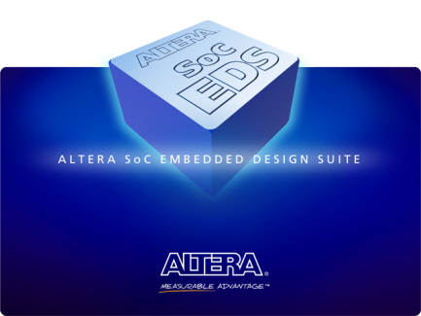
Altera SoC EDS - Key Benefits
Faster time to market, lower development costs
Covers full software development flow for Altera SoC devices
All necessary tools and examples in one package to enable rapid start for developers
Provides software debug views of full SoC by adapting to changing FPGA designs (Subscription)
Unprecedented visibility and control across
processor cores and across CPU, FPGA domains
OEM packing ensures ease of licensing and ease of use

Slide 35
Software Debug & Trace Interfaces & Tools

Slide 36
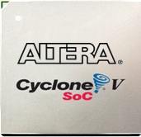
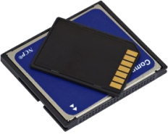
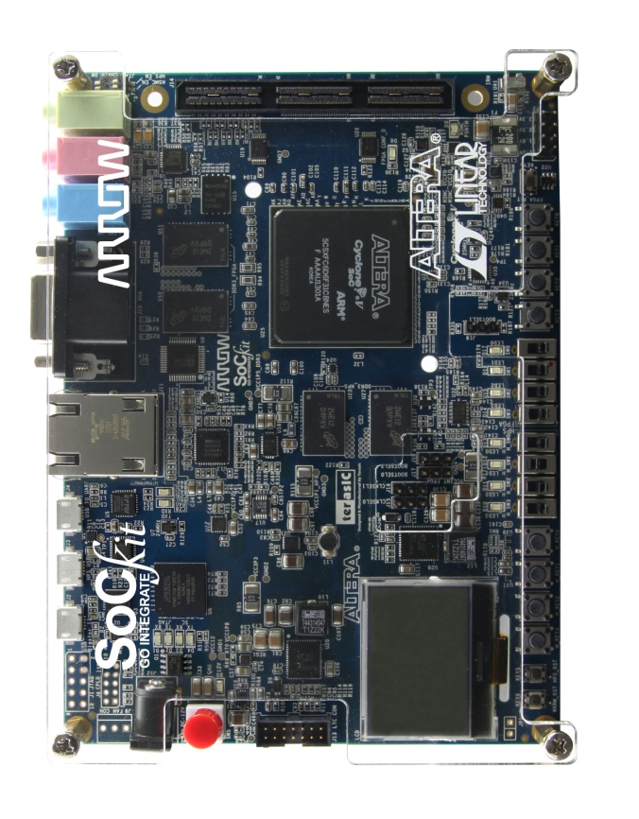

Interfaces for SW Developers
Flash / QSPI / SD
SW tools
Host Machine
Ethernet
Bottom side
SD
Trace
Today’s workshop
JTAG via USB
JTAG

Slide 37
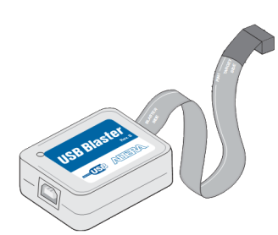
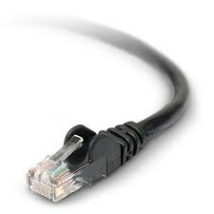
Software Debug Interfaces
JTAG
  Direct connection to hardware
  Halts processor, can master system via control of processor
  Debug any code at low level – driver, OS kernel, bare metal application
  OS aware debugger display optional
  Note: Other debuggers require 2 debugger interfaces for dual-core processors
Ethernet
  Requires running software to drive it
  Processor/OS cannot be halted
  OS Application can be halted
  Good for high level programming (fast, easy)
  Debuggers usually have OS aware GUIs and features
  Cannot do low level debug (kernel, driver, bare metal) as OS cannot be stopped

Slide 38
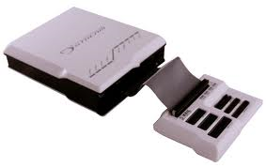
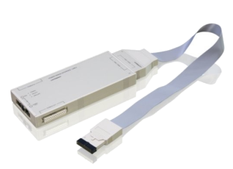
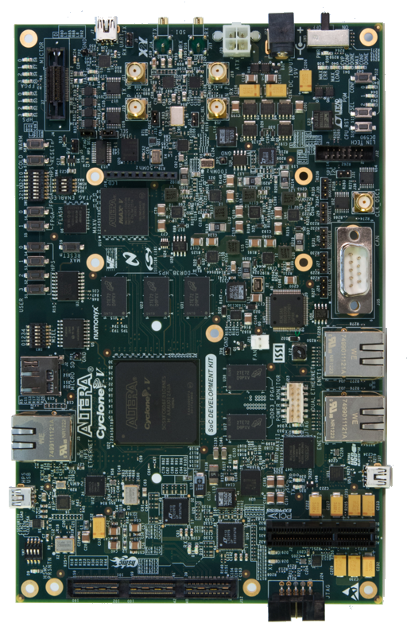
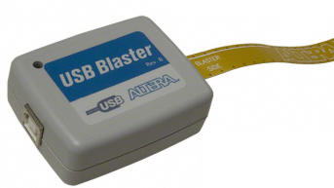
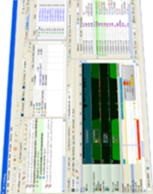
ARM (Software) Trace Interfaces Available
Can design board
With Mictor connector
DS-5
ARM DStream
PowerDebug
Lauterbach
Host Machine
Proprietary
ARM compatible Trace probe
Compatible Software Debugger
Today’s workshop
USB Blaster II
JTAG via USB
DS-5
USB Cable

Slide 39
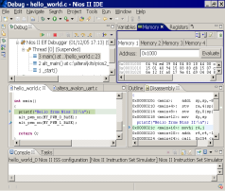

Real-Time Trace (JTAG/Ethernet/USB)
Processor ‘data logger’ system
Runs at full speed to identify and debug real-time software issues
Hardware triggers on predefined condition
  Address value, data value or a combination
Stores instruction or data flow information to on-chip or off-chip memory for analysis in debugger
Trace Capable Debugger
Host
Display
High-speed Connection
(i.e. Mictor conn)
Trace Pod with on-board memory
Processor
Ethernet or USB
Processor
Trace HW
JTAG/USB/Ethernet

Slide 40

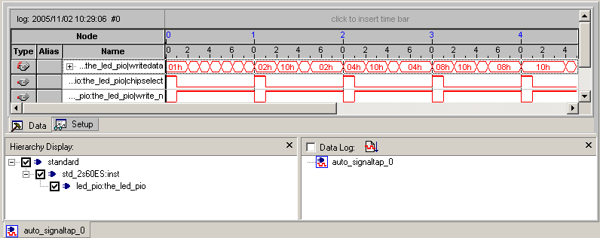
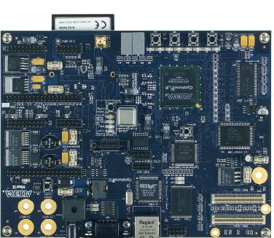

SignalTap™ II Logic Debug Tool (JTAG)
Built in logic analyzer/trace capability for FPGA logic
Captures the state of signals when running at full system speeds
Uses standard JTAG connection to PC
User defines target signals and trigger conditions to capture data
Data read back from memory and displayed on PC
Host
Display
Target
HW
USB
JTAG
S.Tap Logic
Notes:
Up to 200 MHz
Multi-Analyzer Support
1,024 Channels
128K Samples
10 Trigger Levels
No Probes!
Can be used simultaneously with the Nios II IDE debugger and the FS2 console!
The SignalTap® II logic analyzer is a second-generation system-level debugging tool that captures and displays real-time signal behavior in a system on a programmable chip (SOPC), giving engineers the ability to observe interactions between hardware and software in their system designs. Available exclusively in the Quartus® II software, the SignalTap II logic analyzer supports the highest number of channels, sample depth, and clock speeds of any embedded logic analyzer in the programmable logic market. The Quartus II software versions 4.0 and later also provides designers with a graphical interface to define custom-trigger-condition logic to provide greater accuracy and enhances the ability to isolate problems. Figure 1 shows the components of the SignalTap II embedded logic analyzer. The SignalTap II embedded logic analyzer does not require any external probes or changes to user design files to capture a design's state of internal nodes or I/O pins.
Running at speed under real-world system conditions is the ultimate testbench for engineers who want to see the active processes within their design as it operates. The SignalTap II embedded logic analyzer offers designers the ability to capture the state of internal nodes or I/O pins while the device is running in-system and at system speed. The SignalTap II embedded logic analyzer software can now be used in environments with multiple devices in a single JTAG chain, in combination with multiple logic analyzer megafunctions in each device in that JTAG chain. The following components are required to perform logic analysis with the SignalTap II embedded logic analyzer:
Quartus II design software
Soft embedded core megafunctions that are inserted into the device
SignalTap II logic analyzer megafunction
SignalTap II hub (automatically installed when an engineer chooses the SignalTap II logic analyzer in the Quartus II software)
Download cable
USB Blaster download cable
ByteBlasterMV™ download cable
ByteBlaster™ II download cable
MasterBlaster™ download cable
Device under test
Captured data is stored in the device's memory blocks and streamed out to the Quartus II software waveform display using a USB Blaster, ByteBlasterMV, ByteBlaster II, or MasterBlaster communications cable. Table 1 summarizes the features and benefits of the SignalTap II embedded logic analyzer. Detailed descriptions of these features and benefits can be found on the SignalTap II Feature Descriptions web page
FeatureBenefitMultiple logic analyzers in a single deviceSupports multiple clock domains in a single device
Multiple logic analyzers in multiple devices in a single JTAG chainAllows multiple devices with multiple clock domains to be analyzed
Up to 10 basic or advanced trigger levels for each analyzer Allows for more complex data capture commands to be given to the logic analyzer, providing greater accuracy and problem isolation. Version 4.1 adds support for event counter trigger conditions.
Flexible buffer acquisition modesEach trigger can be set up to sample at different ranges relative to the triggering event, in circular or segmented modes, which allows more accurate data collection
Up to 1,024 channels in each deviceEnables sampling many signals and wide bus structures, and allows for a great deal of data collection to locate problems
Up to 128K samples in each deviceProvides sufficient capacity for any practical application
Clock support up to 200 MHzAllows for sampling of design data at system frequency
Ability to incrementally add nodes, change signal selection and change trigger conditions without a full recompilationAllows user to change which nodes are monitored without a full design recompilation
Lock mode to prevent recompilationsPrevents SignalTap II configuration changes that will cause the need for a design recompilation
No-cost stand-alone viewer Allows easy deployment of in-system logic analysis capabilities to multiple lab locations or field service personnel
Mnemonic and radix tablesLabel signals with true signal names from software source to assist in identification of problem source
Multiple bus display formatsMakes viewing and analyzing buses easier (now includes bar chart and line chart display options for captured data)
Export data in multiple file formatsAllows other verification tools to be used to analyze captured data
Resource usage estimatorProvides estimate of logic and memory device resources used by SignalTap II embedded logic analyzer configurations
Auto detection of devices in JTAG chainConfirms connection to device before attempting to initiate data capture
Auto detection of programming hardwareConfirms connection to device before attempting to initiate data capture
Ability to print waveformsPrints captured waveforms for reporting
Vendor-independent application program interface (API) for Source-Level Debugging ToolsAllows third-party software to utilize SignalTap II resources
User-friendly interfaceEasier-to-use with status monitors to guide users through operation
SignalTap II Device Support
SignalTap II logic analyzers can now be used with the following device families:
Cyclone™ devices
Stratix® devices
Stratix GX devices
Excalibur™ devices
APEX™ II devices
APEX 20KE devices
APEX 20KC devices
APEX 20K devices
Mercury™ devices

Slide 41
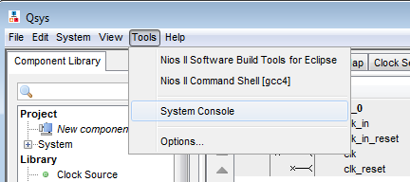
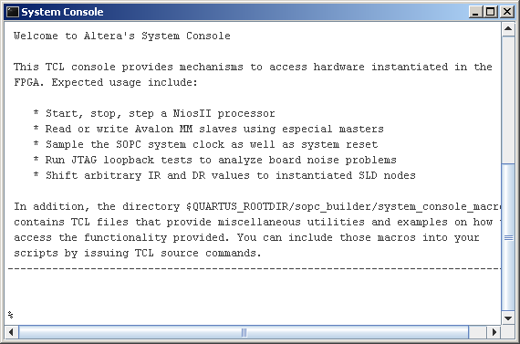
System Console Tool (JTAG)
Provides direct system access at
runtime from TCL command line
interface
  Access via Nios® II processor, JTAG bridge,
  JTAG UART or custom Agent
  Supports Qsys component interfaces
  Use for board bring-up, debug, diagnostics,
  system profiling and configuration
  Open from Command shell or Qsys
In the design
FPGA
Hard Processor System (HPS)
QSys Builder System
System
Console
IP
IP
Nios II
OCI
System
Console
USB Blaster
Sys. Interconnect
SLD
Hub
JTAG
IP
Bridge
See http://nioswiki.jot.com/SystemConsole for sample applications
Notes:
There is a JTAG bridge in the Golden HW Reference design so System Console can probe and modify registers in the FPGA – AND in the Hard Processing system over the bridges

Slide 42
SoC Development Flow
Software Design Flow – Part 1: Preloader and Bare metal

Slide 43
Software Perspective
Application
Software Engineer
Driver
HWLib
SoCAL (Lib)
App
OS
BSP
Registers
Silicon Device
Middle
Ware
IP Cores
Application
Middleware
Hardware
abstraction
Firmware
Software Engineer
Notes:
Primary focus of the Apps and Firmware Developers

Slide 44


System Development Flow
FPGA Design Flow
Software Design Flow
Hardware
Development
Software
Development
Quartus II design software
Qsys system integration tool
Standard RTL flow
Altera and partner IP
Design
Design
ARM Development Studio 5
GNU toolchain
OS/BSP: Linux, VxWorks
Hardware Libraries
Design Examples
ModelSim, VCS, NCSim, etc.
AMBA-AXI and Avalon bus
functional models (BFMs)
Simulate
Simulate
Virtual Target
SignalTap™ II logic analyzer
System Console
Debug
Debug
GNU, Lauterbach, DS5
Quartus II Programmer
In-system Update
Release
Release
Flash Programmer

Slide 45
System Development Flow
FPGA Design Flow
Software Design Flow
Hardware
Development
Software
Development
Design
Design
Software Development
Quartus II design software
Qsys system integration tool
Standard RTL flow
Altera and partner IP
HW/SW Handoff
ARM Development Studio 5
GNU toolchain
OS/BSP: Linux, VxWorks
Hardware Libraries
Design Examples
ModelSim,etc.
AMBA-AXI and Avalon bus
functional models (BFMs)
Simulate
Simulate
Virtual Target
SignalTap™ II logic analyzer
System Console
Debug
Debug
GNU, Lauterbach, DS5
Quartus II Programmer
In-system Update
Release
Release
Flash Programmer

Slide 46

Quick Summary
FPGA:
  Looks like a FPGA
  Works like a FPGA
  Standard FPGA development flow
  Quartus II, Qsys, SignalTap, System Console, USB blaster...
ARM HPS:
  Looks like an ARM processor system
  Works like an ARM processor system
  Standard ARM development flow
  ARM Cortex-A9 compiler/debugger, JTAG tools, program trace...
Back

Slide 47
Software Process: HPS Boot Stages
Boot ROM code
Hardened by Altera into device.
Scans boot select pins to determine clocks/boot source
- NAND, QSPI, SD/MMC, FPGA or On-chip RAM
Sets up PLL’s if selected by clock pins
Configure minimal set of HPS I/O pins to read flash
Performs CRC checking & loads ISW into On-Chip RAM
Reset
SW / FW
Developer’s
efforts
Boot ROM
PreLoader (Initial Software)
Altera Reference code + generated system .c & .h files
Runs from On-Chip memory
Configures scan manager with pin configuration data
Initializes and calibrates SDRAM
Loads Boot Loader code into SDRAM
PreLoader
Boot Loader
Boot Loader
Application / OS specific
Altera provides U-Boot as a reference example
OS
Operating System
Linux, VxWorks, OSE, etc
Device drivers and BSP
Root FileSystem
Application
User Application
IDE and Debug
FPGA configuration

Slide 48

Hardware / Software Handoff Tools
Allows hardware and software teams to work ‘independently’ and follow their familiar design flows
Altera Quartus II / Qsys handoff output files converted into files for the software design flow
Device Tree standard specifies hardware configuration/peripherals so that Linux kernel can boot up correctly

Slide 49

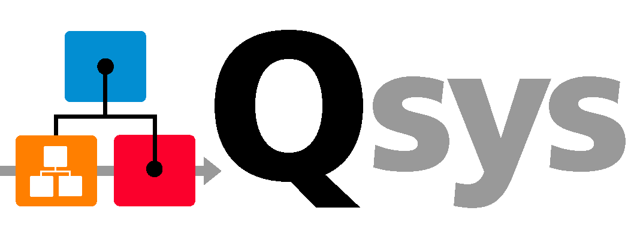
Hardware / Software Handoff
Qsys system info, SDRAM calibration files,
ID / timestamp, HPS IOCSR data
Hardware
ISW_handoff.sys
system.sopcinfo
Preloader Generator
Device Tree Generator
User Options
.c & .h
source files
Linux
Device Tree
Software

Slide 50


Hardware/Software Design Flow Overview
PreLoader
Settings
Directory
Handoff
files
ACDS
Handoff
Preloader Generator
Preloader
HW Design
.svd
DS-5 Debugger
.sopcinfo
DeviceTree
Generator
Device Tree
For
Linux
SoC EDS
.sof
Notes:
Another perspective showing how the SoC EDS ties into the handoff process – including the DS-5 debugger.
Note: Device Tree not supported until 13.0 sp1
.svd file gives shows description of soft IP peripheral registers in FPGA . Located in <hps_qsys_project> directory.
.sopcinfo file is the output of Qsys

Slide 51

Hardware/Software Design Flow Overview
Eclipse/GCC/GDB Software Design Flow
Hardware
Development
Software
Development
Open New BSP Project
Import HW/SW Handoff Files
HW/SW Handoff files
Preloader
Generator
Enter User Settings
Build
Flash Programmer
SOF/POF
Software Image
Flash Image builder
Notes:
High level view of the flows and handoff including flash programming

Slide 52
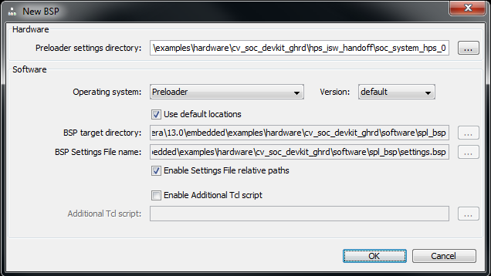
Preloader Support Package Generator GUI
Create new .BSP or import existing
Notes:
Preloader Settings Directory – Path to HW Preloader Handoff Files (Directory)
O/S - v13.0 only supports Preloader
BSP target directory – path to new BSP files
BSP settings file name – location and name of .bsp file
Additional Tcl script – can override the default BSP settings

Slide 53
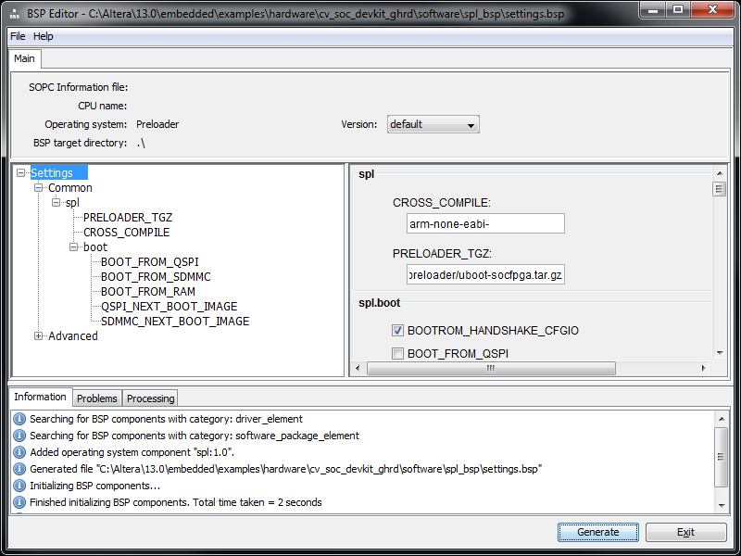
BSP Editor
Tcl: set_setting spl.boot.BOOT FROM QSPI true
set_setting spl.boot.QSPI_NEXT_BOOT_IMAGE 0x5000
Notes:
We mentioned you can load a Tcl script on the previous GUI….here are some commands you could put in the script to customize the BSP settings

Slide 54
Preloader Build Results
In the uboot-socfpga/spl directory you will have:
u-boot-spl <- the ELF image for debugging
  Ready for the debugger
u-boot-spl.bin <- the binary image for the preloader
  Ready for Flash Programmer
In the software/spl_bsp directory:
preloader-mkpimage.bin <- binary of u-boot-spl.bin with
header and replication
  Ready for SD Card
Notes:
  SD Card boot region is not FAT/FAT32 standard
  Requires a tool that can program A2 format partitions to SD Card (Eg. DD)
Notes:
ELF (Executable and Linking Format) is a binary format originally developed by USL (UNIX System Laboratories) and currently used in Solaris and System V Release 4. Because of its increased flexibility over the older a.out format that Linux previously used, the GCC and C library developers decided last year to move to using ELF as the Linux standard binary format also.

Slide 55
LAB: Modules 1 thru 3
Module 1: Getting Started
Module 2: Examine the System
Module 3: Generate, Build and Run the PreLoader

Slide 56
Software Debug

Slide 57
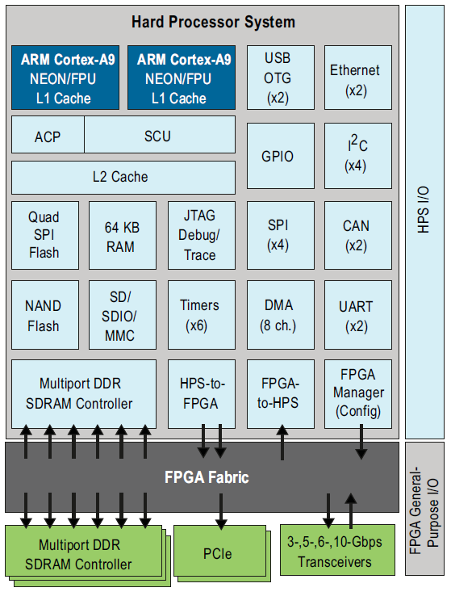
Design Areas on SoC FPGA Devices
Processor System
The domain of software engineers
Problem areas
Identification of HW issues at runtime
Working across SW & HW domains
Coherent real-time HW/SW debug
Drivers for new or changing hardware
System-level performance analysis
FPGA Fabric
The domain of hardware engineers
Notes:
ARM’s DS-5, Altera Edition is uniquely designed to work with Altera’s SoC debug features to give unprecedented visibility and power to overcome classic System-On-Chip debug problem areas.

Slide 58
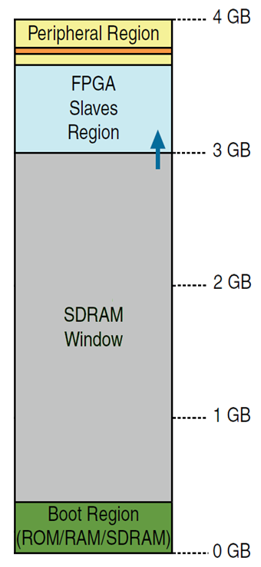

Altera SoC FPGA Based Peripherals
FPGA
FPGA IP mapped
To 3GB and above
MEMORY MAP
FPGA IP
32/64/128-bit AXI
Bridges plus
Lightweight Bridge
32-bit
AXI
AXI
AXI (LW)
L3 interconnect
L2 Cache
Cortex-A9
Cortex-A9
Cortex-A9 0-3(+)GB
memory space
HPS
Notes:
Altera SoCs are architected and designed to provide a superior performance, flexibility and visibility.
The Lightweight AXI bridge gives an alternate path for accessing registers while not interfering with the high performance AXI bridges. (i.e. have large DMA transfers in process).

Slide 59
Cortex-A9 Debug
Interactive Debug
  Controlled via JTAG or CPU monitor code
  6 HW Breakpoints, 2 with Context ID compare
  4 HW Watchpoints
Performance Monitoring
  Each A9 has a Performance Monitoring Unit (PMU)
  Each PMU can monitor 58 different events
    6 counters to count events
    Events may be triggers or put in trace
See Cortex A9 TRM for additional details
Back

Slide 60
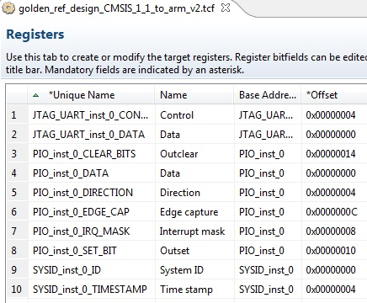
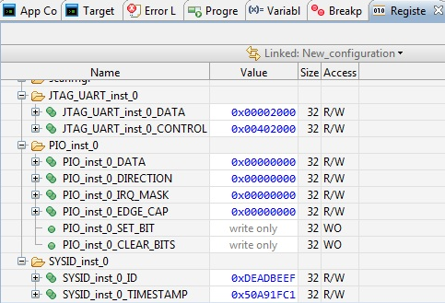
Visualization of SoC FPGA Peripherals – FPGA Adaptive
Register views assist the debug of FPGA peripherals
  File generated by FPGA tool flow
  Automatically imported in
  DS-5 Debugger
  Changes dynamically
Debug views to debug
software drivers
  Self-documenting
  Grouped by peripheral,
  register and bit-field
CMSIS
Peripheral register descriptions
Notes:
Ability to have visibility into FPGA peripherals is exclusive to Altera – through the FPGA Adaptive aspect of ARM’s Altera Edition of DS-5.
Note the CMSIS files coming from peripherals in Qsys allow the registers to be described (offsets, bits, etc).

Slide 61
Altera SoC Debug Architecture
STM: System trace module
PTM: Proc trace module
TPIU: Trace port I/F Unit
CTI: Cross trigger I/F
CTM: Cross trigger module
DAP: Debug Access Port
28 HW signal events
injected into trace stream
FPGA
FPGA IP
Cross-triggers between
FPGA(8) and CPUs (8)
CPUs and
CoreSight compatible IP
implemented in FPGA logic
accessible from Debugger
Trace
SWD/
JTAG
CTI
DAP
Debug bus
System bus
TMC
ETR
STM
Trace bus
Export trace
to trace port,
peripheral or
memory
CTM
PTM
PTM
Full trace capability on
hardened part of the SoC
Ability to inject FPGA
hardware debug data into
the CoreSight trace stream
Infrastructure to trace
CPUs synthesized on
the FPGA
TPIU
Mictor Connector
CTI
Cortex-A9
CTI
Cortex-A9
HPS
Notes:
Altera SoCs are architected and designed to provide a superior software debug experience.

Slide 62
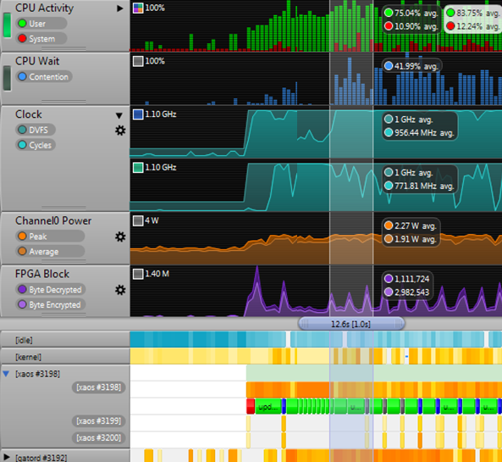
System-Level
Performance Analysis
Performance bottlenecks in SoCs often come from the CPU interaction with the rest of the SoC
Streamline visualizes software activity with performance counters from the SoC and FPGA to enable full system-level analysis
Streamline only requires a TCP/IP connection to the SoC
ARM® DS-5™ Streamline
Linux OS Counters
Processor Counters,
Aggregated, or Per Core
Power Consumption
FPGA Block Counters
Process/Thread Heat Map
Application Events

Slide 63
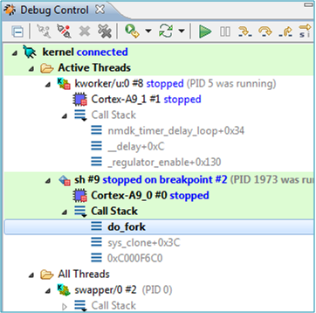
Synthesizing CPUs on FPGA
CPUs and CoreSight compatible IP synthesized on the FPGA are accessible via the Debug Access Port (DAP) and therefore detectable and debuggable by DS-5
DSP
IP
FPGA
SWD/
JTAG
Debug
bus
Cortex-A9
DAP
Cortex-A9
HPS

Slide 64
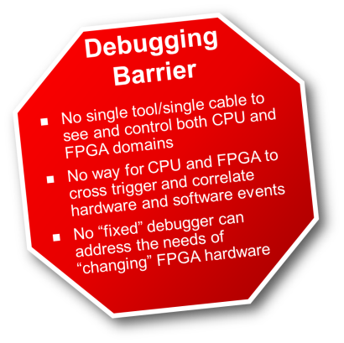
Key Benefits for Developers
Removes Debugging Barrier!
Faster time to market,
lower development costs
Significant productivity gains
Provides software debug views
of full SoC by adapting to changing FPGA designs
Unprecedented visibility and control across
processor cores and across CPU, FPGA domains
Standard, widely used, familiar DS-5 user interface provides SW engineers with rapid starts
OEM packing ensures ease of licensing and ease of use
Notes:
ARM or ALTERA: The tool delivers engineering efficiency, having professional tools at minimum cost. These benefits apply to both software developers and to system developers to solve problems between the system and the fabric. This means lower costs, higher revenue for customers. For software users – they will get the same interface they love with all the features for software development. Great experience for software developer. DS-5 and Signal Tap – customers will get all the info they need to solve any problems.
We are delivering access to professional quality tools at an affordable price.

Slide 65
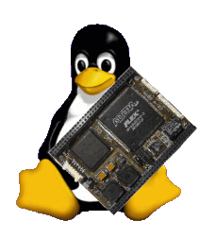
Embedded Linux for SoC
Software Design Flow – Part 2

Slide 66

Getting to the familiar Linux Boot

Slide 67
SoC Linux: Key Takeaways
Linux & tools available for SoC
One of the first ARM multi-vendor platforms supported by a single Linux Kernel v3.7
Leverages new, efficient community methodology for generating custom Linux distributions - Yocto
Innovation on Device Tree to support “changing” hardware profile
  Device Tree Generator (DTG), available v13.0 SP1
Community Portal to facilitate collaboration with developers
Kernel, U-Boot up-streamed and maintained
Notes:
For the Linux Gurus, you can appreciate how much has gone into the support and tools for SoC FPGA Linux – and for the Newbies, we will cover the key pieces that Altera’s Linux team has put together.
Note: Xilinx Zynq is not in the multi-vendor platforms list for v3.7

Slide 68

Linux for SoC: Innovative Approach
We discussed the low level hardware handoff:
Typically developers build Linux for fixed form chips
The SoC Challenge...
How do you build Linux for a chip that changes?
You use a “Device Tree Generator”, of course!

Slide 69

What’s a Linux Device Tree?
A Data Structure for describing hardware
Enables Device Drivers to be linked to Linux kernel at run-time
  No Linux kernel recompile required
  Drivers loaded dynamically after loading Device Tree
  Device Tree embedded in FPGA memory, correct drivers are always loaded
  Can carry additional system information

Slide 70



Device Tree Generator
Altera SoC
Embedded Design Suite
Directory
Device
Tree
Generator
DTS Compiler
Device Tree Source
Device Tree Blob
Board/User Info
Device Tree Generator Ships in Altera SoC Embedded Design Suite – in V13.0 SP1
SD/MMC

Slide 71
Why Use a Device Tree?
Single compiled kernel and set of drivers used on a number of boards
Key with FPGA’s where hardware is easily and frequently changed
Facilitates changing hardware on the fly
Dynamic Device Tree
  Ability to update your FPGA/Device Tree Source without rebooting the kernel
  Available soon

Slide 72
SoC Linux Board Support Package
U-Boot (not pictured)
Kernel
Drivers for SoC
Drivers for the board components
SoC specific layer
Source code for the root file system
Build environment
User Space
(debug, compiler, shell, applications etc)
Kernel
BSP
Drivers
Machine Specific Layer
Board
SoC
SoC Linux BSP release provides all of the components in source code form

Slide 73










What is Yocto?
As stated by the project page:
  The Yocto Project™ is an open source collaboration project that
  provides templates, tools and methods to help you create custom
  Linux-based systems for embedded products regardless of the
  hardware architecture.
Yocto is based on Open Embedded (OE)
  Suite of tools (e.g. bitbake)
  Leverages OE’s architecture
    Recipes, layers
  Makes sure the various components required by OE work together
Notes:
BitBake is a “make like” build tool with the special focus of distributions and packages for embedded Linux cross compilation to build source code

Slide 74

Benefits of Yocto Project
Less time spent on things which don’t add value (build system, core Linux components)
Increased ability to enable key silicon features
Transparent Upstream changes
Vibrant Developer Community
Start with a validated collection of software (tool chain, kernel, user space).
Easy transition to a commercial embedded Linux
"It’s not an embedded distribution
it creates a custom one for you.“
Yocto Project

Slide 75
How does Altera use Yocto?
Added SoC FPGA layer to Yocto
Built source code for our BSP
  Kernel, U-Boot and Root File System
Built the Tool Chain
  GCC, built by Yocto from sources
  Provide pre-built tool chains to reduce build time in the near future.

Slide 76



Linux Software Development Workflow
Target
Portal
Host Machine
Router
Start Console Window
BootROM
Stored in on-chipROM
Start Browser go to Portal
Preloader
Stored in flash, runs from SDRAM
Portal
Clone git Trees
kernel, U-Boot, Tool Chain
U-Boot
Stored in flash, runs from SDRAM
Develop Application
Linux Kernel
Stored in flash/network, runs from SDRAM
Build Image
(Flash/SD/QSPI)
Run Application
Binaries come pre-built in the SoC EDS

Slide 77

Boot Image & Flash Image
Boot Image storage location
Preloader : SD/MMC, QSPI, NAND, FPGA
U-Boot : SD/MMC, QSPI, NAND
Linux : SD/MMC, QSPI, NAND, mass storage, network via tftp, remote PC via UART
Flash Image content
1. Preloader images 2. U-Boot images 3. uImage (Linux) 4. Device Tree Blob | 5. Root file system 6. FPGA POF file 7. Applications 8. User / Application files
Note: EDS doesn’t contain tool to program SD/MMC. Use Linux or Windows tools as shown in appendix. For all other Flash devices, use HPS flash programmer
Notes:
There are lots of places on the HPS that you can store your boot code and images. IF using SD/MMC, we don’t provide a tool to program the image into those flash devices. See appendix for procedure to create

Slide 78
Altera SoC Linux: Key Features and Benefits
Feature | Benefit
Yocto | Standard Build System
Device Tree Generator | Adapts software to changing hardware
Prebuilt Binaries (EDS) | Save time to evaluate boards
Latest Stable Kernel (Kernel.org) | Latest bug fixes, features, security patches
Key Presence in Linux Community | Optimal support & design resources
Altera a designated Maintainer | Confidence in your Linux source: compatibility, longevity

Slide 79
LAB: Modules 4 & 5
Validating Peripherals from the HPS
Validate from the DS-5 Debugger
Validate from a simple Linux App
Validate using Linux drivers (Modules)
Examine the Device Tree Blob
Taking the Next Step: Links, info, training, etc

Slide 80
Advanced Debug

Slide 81



Cross-Domain Debug 1
Trigger from software world to FPGA world
SOFTWARE TRIGGER
OR BREAKPOINT TRIGGER
HARDWARE TRIGGER!

Slide 82



Cross-Domain Debug 2
Trigger from FPGA world to software world
HARDWARE TRIGGER
EXECUTION STOP
SW TRACE TRIGGER!

Slide 83


Correlate HW and SW Events
Debug event trigger point set from either SignalTap™ II
Logic Analyzer or DS-5 debugger
Designers can then analyze the captured trace and timestamp-correlated events
ARM® DS-5™ Toolkit
Timestamp Correlated
SignalTap II Logic Analyzer

Slide 84


Cross-Domain Debug 3
Exploiting the power of CoreSight trace
CPUs
PTM
Timestamp
STM
Timestamp
28 FPGA
Events
STM
Global
timestamp
unit
BREAKING THROUGH THE DEBUG BARRIER!

Slide 85
Altera and the Linux Community

Slide 86
Open Source
Code
Repository
Code
Repository
Founders
/ Admin
Community
Founders
/ Admin

Slide 87
Linux Distribution
Linux OS
Utilities
SW
Development
Tools
Kernel.org
Busybox.net
Applications
GNU.org
x.org
Linux
Distribution
Build Tools

Slide 88

Altera in the Linux Community
Altera awarded maintainership for the ‘SoC FPGA’ architecture
  Kernel (arch/arm/mach-socfpga)
  U-Boot (altera/socfpga_cyclone5)
Being a maintainer means
  Upstream the SoC related code
  Control the changes against the SoC code requested by the community
SoC FPGA is 1 of the 5 ARM platforms included in Kernel v3.7
  Build one kernel that contains support for 5 ARM platforms
Open Source Community
Kernel.org, U-Boot, Yocto, Android
upstream
Maintainer
Public
Repo/git
Customers & Partners
Contributors
Notes:
Linux Kernel v3.7 will come out supporting the following 5 SoC platforms: Altera’s SoC FPGA, VExpress, Highbank, Picoxcell and Mvebu

Slide 89
Software Delivery
SoC Embedded Development Suite (EDS) will be shipped with the Altera ACDS distribution (Quartus II, etc.)
  Stand alone install
The Portal site RocketBoards.org will host the SoC Linux GIT server to deliver upgrades, patches, etc.
Commercial OS vendors will distribute through their normal channels
Notes:
In software development, Git (/ɡɪt/) is a distributed revision control and source code management (SCM) system with an emphasis on speed.^{[3]} Git was initially designed and developed by Linus Torvalds for Linux kernel development; it has since been adopted by many other projects. Every Git working directory is a full-fledged repository with complete history and full revision tracking capabilities, not dependent on network access or a central server. Git is free software distributed under the terms of the GNU General Public License version 2

Slide 90



Welcome to the RocketBoards.org!
  http://rocketboards.org
Silicon
Boards
Frequent Updates
Major Linux release
SDK
Mailman
Existing developer starts here
gitweb
Support
Project Repositories
Soft IP
Forum
Kernel Repository
U-Boot Repository
lists.rocketboards.org
git.rocketboards.org
Dynamic Docs
Links to partners
FOSWiki
rocketboards.org
Altera.com
Static docs
New developer starts here
Mail list server
Linux Portal
One User Experience

Slide 91



Coordinated Multi-Channel Delivery
QII
SoC EDS
.org
Altera.com
Major Releases
Binaries of Kernel, U-Boot,
Yocto, RFS
Source for
Kernel, U-Boot
Yocto, min. RFS,
GNU Toolchain
Documentation
Altera.com
Prebuilt Binaries:
Kernel ,U-Boot,
Tools, yocto,
Minimal RFS
GNU Toolchain
Eclipse IDE
Libraries/APIs
SoC Tools
Sample Apps
GHRD, Drivers
Ref Designs
RocketBoards.org
Source for Kernel
U-Boot & Yocto
Updates
Patches
Public GIT
Wiki
Forum
List Server
Market place
Partner centre
Partners
OSs
BSPs
Middleware
3rd Party Tools
Support
Design Services

Slide 92
Linux Mainline Release Cycle
~Weeks: 0 ~12 Weeks ~24 Weeks
v3.8 Development
v3.9 Development
3.7.1
3.7.1
Mainline
Kernel Development
Branch
(Kernel.org)
v3.7
v3.8
v3.9
rc1
rcn
rc1
rcn
rc1
Merge Window
Stabilization
Merge Window
Stabilization
Merge Window
Community
Accepted
Code &
Altera
Upstream
New Features
No New Features
Bug Fix Only
New Features
No New Features
Bug Fix Only
New Features

Slide 93
Altera Linux Executive Summary
Altera always moves to the latest kernel version
(~3 months) – See Addendum release cycle info
Altera maintains the Linux SoC architecture and upstreams to the very latest kernel
(development branch)
Community focus on branch maintenance
For maintenance of older kernels/branches, customers must work with Linux partners
Common strategy (eg. TI, Freescale, etc)

Slide 94
Linux Availability Summary
Mainline kernel version – kernel.org/EDS
Development version of mainline kernel – Kernel.org
Community maintained Branches – Altera GIT server
Update and patches - Altera GIT server

Slide 95
LAB: Module 6
Module 6: Advanced Debug – Cross triggering
- DEMO

Slide 96
Resources & Next Steps
Training
Altera’s Cyclone V SoC Development Kit
Links & Support
Next Steps

Slide 97


Altera SoC Dev Kit Contents
FPGA Design Software:
  Quartus II Web Edition, ModelSim (Altera Starter Ed)
  Golden Hardware Reference Design
Software Development Development tools (EDS):
  GNU tools, Eclipse IDE, ARM DS-5 Debugger
  Linux distribution & full BSP
  Altera HW lib (APIs for Altera “manager” IP)
Out-of-Box Experience
  Web Server (Linux) Application
    Links to resources web resources
    (documentation & downloads)
    Board update portal
  Board test system (board HW verification)
  Golden HW reference design (getting started)
  Web portal for one-stop Embedded SW download

Slide 98

Altera’s Dev Kit: Golden Reference Design
HPS configuration
  DRAM, QSPI, SD/Card
  All peripheral functions exposed at least once
  Drivers
    HAL
    Linux
FPGA configuration
  Simple Qsys “sandbox” system
    First experience in ARM / FPGA integration
  Getting started guide to walk them through the process integrating IP
    HW simulation
    Verification via system console
    Verification via CPU
    HW/SW hand-off
ARM A9
NEON/FPU
ARM A9
NEON/FPU
DDR/SDRAM
I$
D$
I$
D$
L2$
TMC/Trace
QSPI
USB OTG
GPIO
USB OTG
I²C
Ethernet
I²C
Ethernet
ROM
UART
SD/MMC
UART
NAND flash
RAM 64KB
SPI
SPI
FPGA mngr
CAN
DMA
CAN
TIMERS
HPS
HPS► FPGA
HPS► FPGA
Low latency
FPGA►HPS
FPGA
JTAG
Master
Memory
SYSID
PIO
PIO

Slide 99

Resources, Links & Support
SoC Altera.com Site here
Altera Dev Tools
  Quartus II Design Suite – includes Qsys
  Quartus II Literature, Handbook, etc.
  SoC Embedded Design Suite (EDS)
  Design Software & Download Center Sites
ARM Dev Tools
  DS-5 Altera Edition
  www.arm.com , ARM SW dev tools
Altera Forum Community: www.alteraforum.com
Altera Wiki Community: www.alterawiki.com
  SoC / Linux Web Portal: http://rocketboards.org
Support info & Links
  Altera’s MySupport – for submitting Service Requests – GO SIGN UP!
  Altera’s Design Resources Site

Slide 101
Addendum A
Example Designs

Slide 102
ADDENDUM - Example Designs
Application | Description | Provider | Availability
Starting point | Golden reference design | Altera | NOW
AMP | Asynchronous Multi-processing | Altera | 2H 2013
TrustZone | Security | Altera | 2H 2013
PCIe Root Port | Linux supporting PCIe RP | Altera | 2H 2013
Android | OS / GUI acceleration | Fujisoft | 2H 2013
Motor control | Drive-on-a-chip | Altera | 2H 2013
Video Analytics | Automotive driver assistance | Altera | 2H 2013
Industrial control | PLC-on-a-chip | Altera | 2H 2013
Safety | Industrial safety | Altera | Beyond v13.0

Slide 103
Addendum B
Downloading & Licensing SoC EDS software

Slide 104
SoC EDS: Downloading and Licensing
The only software within the SoC EDS that is FLEXlm licensed is ARM DS-5, in three licensable configurations:
  Full featured DS-5 Altera Edition in the Subscription Edition
  30-day Evaluation of the Subscription Edition
  Perpetually free version with gdbserver/ Ethernet debugging support
It is a three-step process to download and license SoC EDS (including DS-5)
  Download SoC EDS (includes DS-5) from Altera Web
  Install
  Use DS-5 built-in License Manager to request license

Slide 105



ARM DS-5 Download and Licensing Process
1
Download SoC EDS from Altera Download Center (Includes DS-5)
2
Install on Windows or Linux Workstation
In ARM DS-5, go to Licensing Manager
Help-> ARM License Mgr,
Click on “Add License”
Select license type and enter info:
Serial Number, NIC ID…
3

